Slide 1
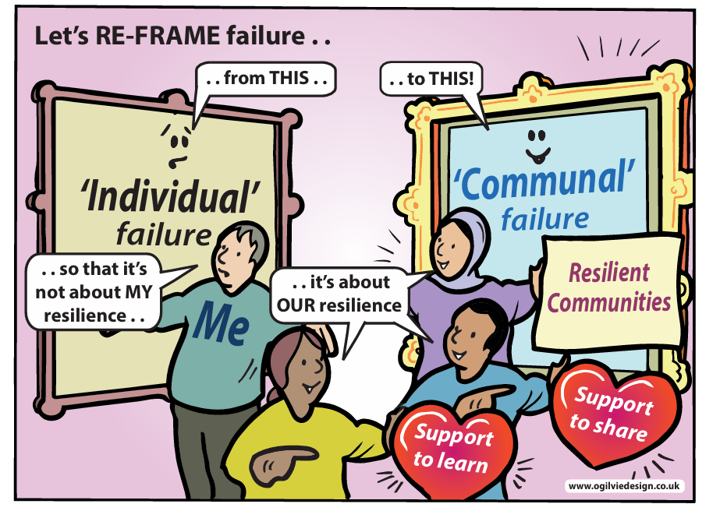
Collegial Cultures
A toolkit for developing resilient Research Cultures in ACademia

Slide 2





Dr Fiona O’ Hanlon, Director of Ethics, Moray House School of Education, University of Edinburgh
Professor Gale. MacLeod, University of Edinburgh, Moray House School of Education, University of Edinburgh
Dr. Robin Dallas-Childs, Research Associate, University of Edinburgh
Dr Dely Elliot, School of Education, University of Glasgow
Dr Darcey Gillie, Freelance Careers Consultant, The Career Doctor
InFrame Project 2026 by InFrame is licensed under CC BY-NC 4.0. To view a copy of this license, visit https://creativecommons.org/licenses/by-nc/4.0/
This work is licensed under CC BY-NC 4.0

Slide 3
Table of Contents
*based on themes from our research
01 | Introduction
02 | Summary of our research
03 | “How do we get up again?”: Tools for dealing with professional setbacks
04 | “We’ve created this really lovely network… a great support to one another.”: Tools for creating resilient micro-cultures
05 | The Big Picture – Mapping Your Spheres of Influence & Taking a Strategic Approach to Creating Resilient Research Cultures
06 | Action Planning & Workshop Facilitation Guide

Slide 4
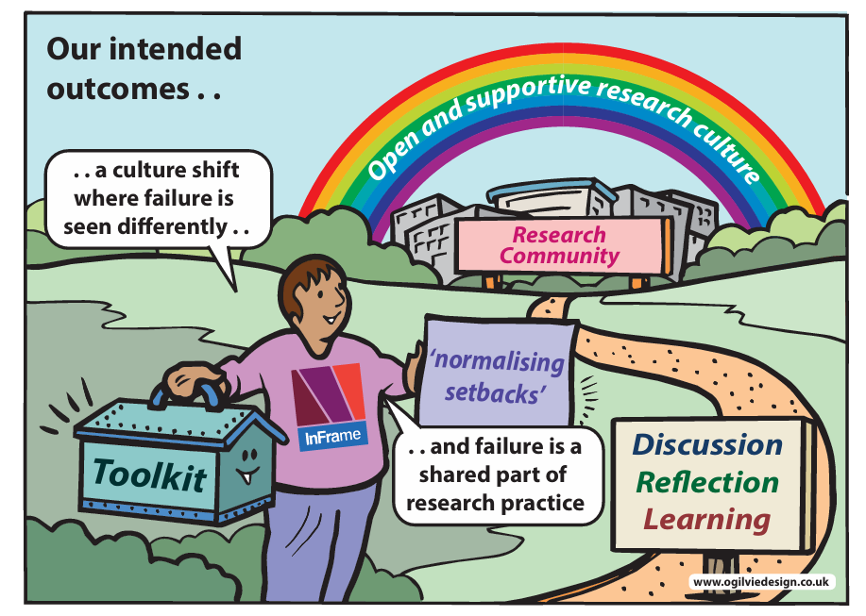
01 Introduction
We get knocked down. How do we get up again? Responding to failure and the role of collegial leadership in creating resilient research communities.
This toolkit is designed to support researchers and research leaders in creating research cultures that value resilience and learning from professional setbacks. Based on research with colleagues, the focus is on the importance of collegial dialogue - conversation - and ‘microcultures’ in building healthy and resilient research environments. This resource provides a starting point for reflection and action, with the goal of developing sustainable research cultures where professional setbacks are not stigmatized, but seen as an opportunity for development, change, and growth.
Each section provides information, advice, and self-reflective questions to help users develop their own approaches to fostering a resilient research culture. The toolkit is designed to be accessible and useful for researchers at all stages of their careers, from early career researchers to senior leaders. By using this toolkit, we hope to create a community that values open dialogue, empathy, and support, and where failure is normalised as a natural part of the research process.

Slide 5
Why Resilience Through Collegial Dialogue?
“We’ve created this really lovely network… a great support to one another.” Mid-Career, Arts, Humanities, and Social Science
“Good research comes from connecting - collaboration brings more back to you.” Senior Leader, Social Science
“You need to create a culture with constant feedback loops.” Senior Leader, Arts, Humanities, and Social Science
“Essentially my first response is to normalise failure… partly through storytelling… around my own career.”
Senior Leader, Medicine
Research environments are social worlds. In our research, we discovered that conversation in various forms and the existence of microcultures of practice and dialogue – e.g., journal clubs, work-in-progress groups – were amongst the activities cited in helping to make a resilient culture where professional setbacks are normalised and dealt with constructively. With this in mind, this toolkit focuses on providing some ideas, options, advice, information, insights, questions for reflections to support the development of collegial dialogue and microcultures to help “foster a system where everyone is valued and appreciated” (UKRI).

Slide 6
A toolkit’s purpose is to make life easier. When we face issues of concern or significance, especially ones that are new or complex, or face problems where the solutions are unclear (and unlikely to be permanent), a toolkit can help us quickly translate information, advice, and theory into action. This toolkit is not prescriptive. It’s aimed at supporting reflection and suggest ideas based on the diversity of perspectives from our research.
In this toolkit, we’ve provided some minimum background information on the topics that emerged from our research but focused on tools that can help you reflect on your needs, along with suggestions for potential actions, including using the toolkit to develop & facilitate your own training.
What is a toolkit?

Slide 7
02 Summary of research
We get knocked down. How do we get up again? Responding to failure and the role of collegial leadership in creating resilient research communities.
The context
This toolkit is based on research exploring how researchers experience and respond to professional setbacks, and the role of collegial leadership in shaping resilient research cultures. Failure, whether in the form of rejected papers, unsuccessful funding bids, or missed opportunities is a common but often unspoken feature of academic life, with significant implications for wellbeing and career development.
Our approach
Through a combination of policy analysis across the three InFrame universities (The University of Edinburgh, Glasgow and St. Andrews) and over 70 interviews with researchers at different career stages, this study examined how failure – or professional setbacks - are currently understood, experienced, and supported in practice.

Slide 8
Findings
The findings highlighted that while institutional policies often emphasise individual resilience, researchers consistently pointed to the importance of collegial environments in enabling discussion, emotional processing and constructive reframing of professional setbacks. Interviewees reported three key stages in effectively recovering from professional setbacks: (i) taking time for emotional processing, (ii) discussing with others, and (iii) identifying practical and realistic routes forwards, which are within researchers' spheres of influence. By spheres of influence, we mean things that we have the power to influence within our team, institutional and wider funding research environment. Interviewees valued collegial team cultures which are characterised by behaviours such as active listening, collaboration, and shared reflection, and in which failure is accepted, anticipated and planned for, not just reacted to.
This toolkit
This toolkit translates these insights into practical resources to support individuals and teams to build supportive research cultures, where professional setbacks are recognised as a normal and valuable part of research, and where resilience is understood as something we develop individually and together.

Slide 9
“It's not necessarily failure. I always consider that the ability to even send out…drafts to journals…it’s success. …but I always find it's encouraging to know more about the stories behind [someone else’s experiences].”
“We prefer ‘professional setback’ to failure.”
We use both ‘failure’ and ‘professional setback’ in this toolkit, as some researchers prefer the latter. Feel free to choose the language that works best for your needs and context.

Slide 10
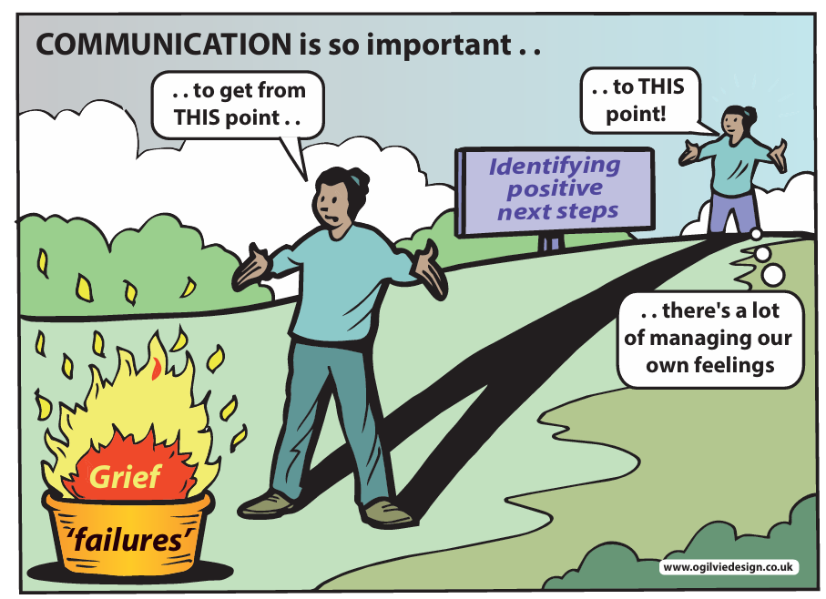
03 How do we Get uP Again?
Tools for dealing with professional setbacks
“…the norm … is … getting knocked back.”
Senior Leader Arts, Humanities, & Social Science
Recovering from failure is an important part of personal and professional growth. ‘Catharsis’ is a formal way of describing the processing and release of emotions, especially after a difficult experience. Research suggests that focusing on learning from and dealing with our emotions instead of ruminating on ‘the event’ can help us achieve some emotional relief - catharsis - from professional setbacks.
In this section, we'll explore how to build our emotional intelligence toolkit to manage the feelings of failure more effectively, to support ourselves and our wider community.

Slide 11
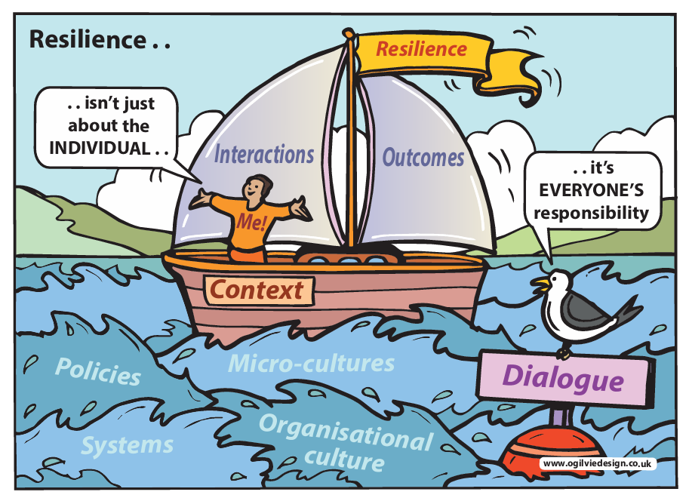
A Personal resilience Response TOOL
Experience a professional setback:
First, go for walk/a swim/a run/bake a cake/knit a jumper/play a video game/do some garden – take yourself away from the immediate experience and the raw feelings.
Then, seek out allies and mentors. Empathy will help validate your feelings (or supportively challenge harmful ones)
Finally, think logically and objectively about what was in your control, what was outside of your control, and be honest with yourself about anything you could have done differently – if anything.

Slide 12
Avoid isolating yourself
Recognise impostor syndrome
Be objective & non-judgemental
Know your coping strategies
Essential Strategies
Ask for help
Learn from the experience
Take
breaks
Notes:
UNTIDY

Slide 13
A Tool for Benchmarking Your Emotional Intelligence
}
Who are your role models when it comes to emotional intelligence and failure resilience? What do you admire and why?
What are ways you can use your emotions to inform your decisions and actions, rather than simply reacting to them?
How might your emotional responses to professional setbacks be influencing your relationships with others in your work environment, and the research culture more widely?
How can you create a supportive environment for others to share their emotions and experiences?
How well do you model healthy emotional expression and encourage open communication within your team.? Are there things you can do differently or better?
Early-Career
Mid-Career
Senior Leader

Slide 14
Ideas for action
Mid-Career Researchers & Senior Leaders
What opportunities can you create for others to share their emotions and experiences, e.g., regular check-ins, feedback sessions, informal coffee catch-ups &c?
What training could help you develop your emotional intelligence as a supervisor, manager, leader?
Could a coach or mentor support you?
Are there opportunities to improve the informal support, advice, and feedback cultures around you?
Early and Mid-Career Researchers
What training could help you develop your emotional intelligence?
Could a coach or mentor support you?
What opportunities are there for you to influence by e.g., organising training for networks or other groups you’re a part of? Write an article? Something else?

Slide 15
Experience of Major Set-backs: Reflecting on Your Personal Support System
}
How do I typically respond to setbacks, and are there any patterns in my thoughts, feelings, and behaviours that may be holding me back?
Does imposter syndrome or a lack of intellectual humility hinder my progress, and if so, how can I reframe my thinking to overcome these limitations?
How can I focus on changing my situation, enriching my resources, and strengthening my personal growth and development?
What practical and viable steps can I take towards constructive recovery, rebuilding, and repurposing the results of my efforts when they don’t work?
What skills or knowledge, such as structural literacy (‘the rules of the game’), can I acquire to better navigate challenges and achieve my goals?
Who are my allies, and how can they support me in achieving my personal goals?
Early-Career
Mid-Career
Senior Leader

Slide 16
emotionally Intelligent research Cultures
“there are ways in which culture can be positive while also having to live alongside the inevitability of competition.”
What is emotional intelligence? | The ability to recognise, understand and manage our emotions & the ability to recognise, understand, and influence the emotions of others. Emotionally intelligent workplaces start with investing in and cultivating emotional intelligence in individuals., emphasising the importance of interpersonal competencies
Why is it important? | It improves productivity, engagement, enjoyment, motivation, increases job satisfaction and can reduce feelings of burnout
Characteristics | Individuals – empathy, self-awareness, advanced communication skills including active listening Teams – trust, responsibility, open communication, effective conflict resolution, highly collaborative
Ideas | Emotional intelligence Training Needs Analysis Clearly valuing emotional intelligence Fostering a skilled feedback culture Opportunities for storytelling Recognising and celebrating ‘small’ wins Making coaching & mentorship available
Early-Career, Medicine

Slide 17
Case studies
Active Listening
04 “We’ve created this really lovely network… a great support to one another.”*
Tools for creating resilient micro-cultures
*Mid-Career, Arts, Humanities, and Social Science
advice
Feedback

Slide 18
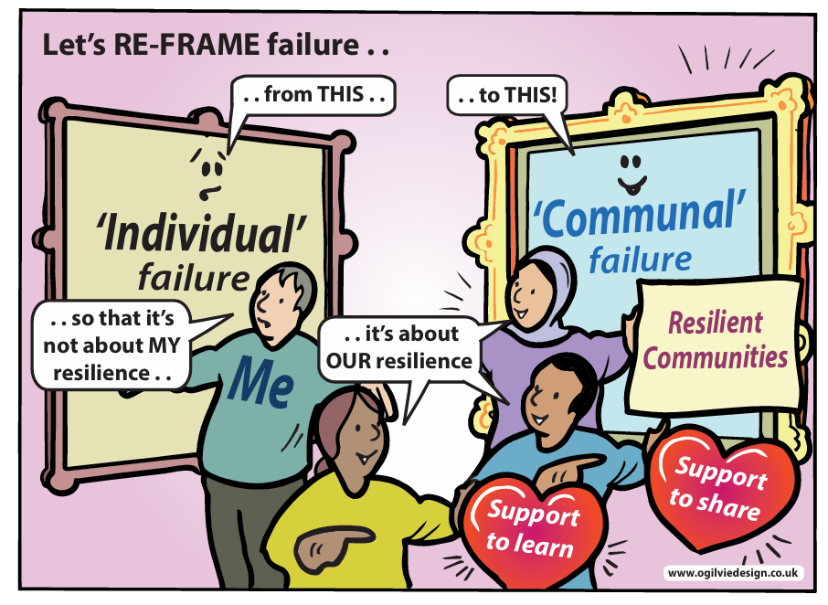
“We (within a micro-culture) celebrate successes together and mull over failures together.”
Senior Leader, Social Sciences

Slide 19
Building Effective Microcultures
In our research, we discovered that conversation in various forms and the existence of micro-cultures of practice – journal clubs, work-in-progress groups, etc. –were the activities most often cited in making a resilient and healthy culture of failure.
What are micro-cultures? | Culture in an organisation is “the way things get done”. ‘Micro-cultures’ reflect subtle variations in how work gets done in different teams, functions, and places.
Why are they important? | Micro-cultures shape the attitudes, values, and behaviours of individuals, groups, and the wider organisation. They can support positive job performance and satisfaction. Healthy micro-cultures can create a greater sense of community, promote diversity & inclusion, and foster innovation.
Characteristics | Psychological safety, open communication, respect, empathy, accountability and ownership, mutual support, values and celebrates diversity & inclusion, emotional intelligence, trust, transparency, supportive challenging, honesty, knowledge-sharing, values life-long learning & CPD.
Ideas | Benchmark existing micro-cultures – look for opportunities to strengthen or create communities Foster interdisciplinary activities to reduce isolation and promote innovation Professional Development Opportunities – e.g., promote training, external engagement, mentoring, career development programmes &c Feedback activities Informal social gatherings

Slide 20
Experience of Major Set-backs: Reflecting on Building Micro-cultures
}
Huge radical changes might not be realistic. What is within my gift when it comes to creating micro-cultures?
a) for myself?
b) for others, e.g. ECRs?
How can my actions (e.g. creating micro-cultures) eventually improve research culture?
“Units, clusters, teams, thematic groups, centres that serve as kind of catalysts for mutually supportive research grant activity, as opposed to the isolated academic [create collegial, resilient cultures]”
Senior Leader, Arts, Humanities, and Social Science
Early-Career
Mid-Career
Senior Leader

Slide 21
Case Study
EngDocSoc is a new postdoc-led initiative in the School of Engineering at the University of Edinburgh. Created to be a “positive, supportive, inclusive, environment” and a “collective voice for postdocs”, EngDocSoc provides “opportunities for skills sharing, professional development, & networking.”
The Society has a sharepoint site, hosts regular ‘Payday Coffees’ for informal conversation, organises a Writing Club every 2 weeks, and is building a more comprehensive programme of events.

Slide 22
Case Study
Long-term Research Staff (LTRS) Network, University of Edinburgh is a network established in 2021 for staff on research-only fixed-term contracts (or open-ended, subject to funding) for more than 8 years in total.
It was created to address the isolation felt by many LTRS, and aims to provide 1) a forum for LTRS to exchange stories, contacts, ideas, advice, etc & 2) a space to organize talks, discussions or debates around themes specific to long term or career researchers.

Slide 23
Case Study
The Line Manager Charter at the University of Glasgow in the School of Health and Wellbeing aims to establish consistent, positive microcultures across research teams, while remaining adaptable enough that other Schools or institutions could tailor the framework to reflect their own values, structures and local context.
It was co-designed through our School Culture Group, reviewed by senior leadership, ECA group and Athena Swan colleagues and developed collaboratively rather than imposed from the top down.
The Charter aims to strengthen day-to-day research culture by making expectations between line managers and managees explicit, promoting open communication, mutual accountability, inclusive leadership and wellbeing, while providing practical guidance for navigating difficult conversations before issues escalate. Rather than being a standalone document, it is intended to become part of the fabric of the School through induction, regular line management meetings, annual P&DR discussions and wider School communications, supported by clear reporting pathways and signposting to support.

Slide 24
The researchers we interviewed identified Active listening as one of key characteristics of effective support from peers and managers..
How do we create healthy microcultures?

Slide 25
What is Active Listening?
Active listening is a key behaviour in effective peer support systems and leadership. It helps build trusting relationships and creates a resilient research culture where the experience of professional set- backs is normalised and discussed. Active listening shows that we value our colleagues and are genuinely interested in their emotions and perspective. Because active listening fosters trust, it can contribute to psychological safety in microcultures enabling people to share new ideas, challenge assumptions, and admit mistakes without fear of being shamed. Active listening also fosters inclusivity, feelings of belonging, and enables authenticity. When we feel heard, we also feel valued for our differences as well as what we have in common with colleagues.

Slide 26
Active Listening
Create respectful spaces for colleagues to share emotions.
Focus on understanding through non-verbal cues.
Use techniques such as summarising & paraphrasing to show you understand.
Be mindful of self-disclosure and set boundaries, including a time boundary..
Close the conversation with gratitude and support.
Evaluate your listening skills against models such as SIER or the 5 Levels of Listening.
Identify your strengths.
Identify areas for development and take action.
REFLECT
Think about a time when you felt truly listened to - what did the other person do to make you feel that way?

Slide 27
“Feedback… is very helpful for knowing where to strengthen it next time. I think that’s crucial really.”
Early Career, Medicine
The researchers we interviewed identified Feedback, and by extension, advice as key characteristics of effective support from peers and managers.

Slide 28
What does it mean to give helpful advice?
Giving helpful advice requires good active listening skills. When we’ve heard our colleague’s story, we can interpret it impartially and accurately, perhaps providing a needed alternative perspective. This enables us to share informed opinions and make suggestions grounded in evidence or based on our personal experiences. Advice givers are objective, non-judgmental, and aware of their own biases. Helpful advice communicates complex information in a clear and concise manner, using metaphors, examples, and anecdotes to illustrate key points can help bring the advice to life. Advice givers don’t solve problems - effective advice giving empowers individuals to make informed decisions, build confidence, and develop their own problem-solving skills.

Slide 29
How to give advice
Listen carefully, ask questions to clarify the person’s needs, summarise or paraphrase what they are saying to ensure understanding
Be objective and non-judgemental. Provide advice that is unbiased, fair, and respectful. Avoid unhelpful criticism or diminishing the other person’s thoughts and feelings
If appropriate to the situation being discussed, ensure problems are focused on issues not people. Offer advice that focuses on things that can be changed – actions, behaviours, processes. Avoid personal criticisms.
Remember: offer suggestions not solutions. Our advice should empower the other person to make decisions, not impose our solutions or world view.
Be as clear and concise as possible.

Slide 30
Advice Training
Recognise & Reward effective advice practices
Shift away from ‘blame & Shame’
Benchmark existing advice practices
Creating Cultures of Effective Advice Giving
Providing time & Space for reflection & learning from advice
Leaders model asking for advice & giving effective advice
Ensure 1:1s aren’t just ‘status updates’ – focus on well-being, careers, &c
Notes:
UNTIDY

Slide 31
Building Effective feedback cultures
“You need to create a culture with constant feedback loops.”
What is feedback? | Feedback is information or responses given to an individual or group about their performance, behaviour, or outputs &c. It is a process of providing constructive criticism, suggestions, or evaluation to help the recipients grow, and develop. Feedback can be formal or informal, and it can be provided by supervisors, peers, colleagues, or even self-assessment.
Why is feedback important? | It involves providing specific, actionable, and developmental information that enables individuals to understand the implications of a piece of work or actions, identify strengths to reinforce them, and/or areas for development. A good feedback culture contributes to work environments of trust, collaboration, creativity, productivity, job satisfaction, and well-being. It helps individuals feel more confident and grounded.
Characteristics | Timely, relevant, emotionally intelligent, compassionate, actionable, objective, impartial, constructive, specific, two-way – feedback discussions should be a dialogue.
Ideas | Benchmark existing feedback culture and practices Establish a clear and shared vision for feedback practices Value & reward effective feedback practices Train and support staff Foster a culture of psychological safety Implement regular feedback mechanisms and activities

Slide 32
Case Study
The School of Health and Wellbeing at the University of Glasgow uses the concept of ‘listening posts’ to temperature check the culture and to identify meaningful actions for change.
Listening posts can be as formal or as informal as needs be – it’s any sort of channel which an organisation poses questions to understand and respond to a given issue. It can take the form of an email suggestion box, post-its, an online form or poll – choose the method that suits your aims and context best.

Slide 33
05 UnderstanDing Your Spheres of Influence
One important thing is to know where we have the power to make a change. This is called our "sphere of influence". They are the areas where we can make a difference. When we understand what these areas are, we can focus on them and make progress. We can also help others to do the same. This means we can set goals that are realistic and achievable. As a result, we can create a positive and supportive environment, even when things are difficult. By working together and using our power to make a change, we can create a strong and supportive research community. Oftentimes, we don’t realise how wide our sphere of influence could be and focus too much on ourselves or the immediate environment around us. Leaders can also underestimate or forget the power they have to expand the spheres of influence of early- and mid-career researchers.

Slide 34
Why is understanding Sphere of Influence important?
In the context of recovering from a professional setback, considering your spheres of influence helps you regain control, focus on what matters, and take deliberate steps towards improvement and growth. By focusing on what you can control, you can start to feel better and make positive changes.
Ruminating on factors outside of our spheres of influence when we experience a professional set back is natural. We are trying to develop a sense of what happened and why, to problem-solve in order to do what we can to prevent similar situations in the future, and to gain some sense of certainty.
Ultimately, though, not focusing on the things within our control is counterproductive. We spend time futilely worrying about things we can’t change and miss opportunities to change things we can. Focusing on factors outside of our spheres of influence can be a way of avoiding taking action.

Slide 35
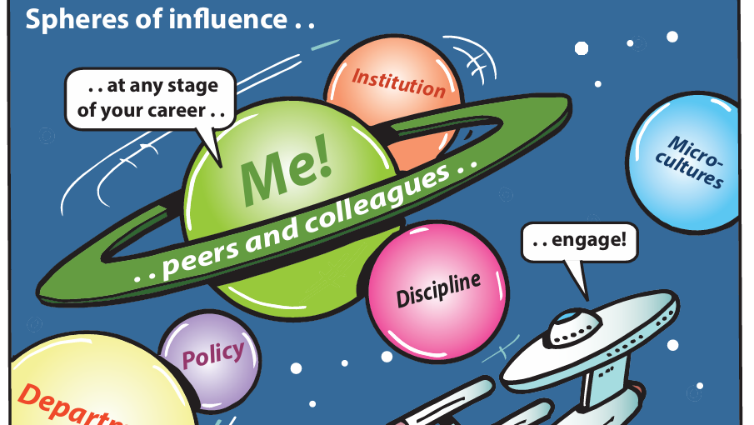

Slide 36
Change this slide Map your spheres of Influence to…
Focus on what you can control: When you've experienced a failure, it's easy to get caught up in emotions and feel overwhelmed
Let go of what you can't control: You can let go of anxiety and stress related to those things, helping you conserve energy and focus on where you can make a difference.
Identify areas for improvement and make realistic changes to prevent (as much as possible) similar set-backs in the future
Develop a growth mindset where you see failures as opportunities for learning, and clues for when a change of course might be needed
Build self-awareness about your connections and networks. You can stop focusing on areas of strong, healthy ties, and start nurturing weaker areas, exploring how neglected or missing connections could help you.
Reduce rumination and blame: When you focus on what you can control, you're less likely to ruminate on what went wrong and unfairly blame yourself or others.
Create a sense of agency and empowerment. This helps motivates you to take action, make changes, and work towards recovering from the failure by focusing on where you can make real, concrete impacts

Slide 37
At any stage of your career engage with….
…national policy bodies, think tanks, and similar organisations
…departmental/ institutional networks
Policy
Institution
…your own training & development needs
…your elected representatives about the realities of research careers
Department
Yourself, Immediate Peers & Colleagues
….opportunities to support
…learned societies & professional bodies
Discipline
….opportunities to influence

Slide 38
Early- & mid- Career Researcher
Use the map to reflect on your spheres of influence. List all the places you are or could have influence at every scale. Are you making the most of the influence you have? Are there opportunities to extend it? Are there opportunities to help others extend theirs? What support do you need to take action?
Organise training on a topic that can help peers and colleagues cope with professional setbacks
Make use of available careers & researcher development support
Start a Coffee and Cake club, Journal club or Writing club
Join an institutional postdoc network/society
Initiate a peer coaching network for your discipline/learned society/professional body
Look for opportunities beyond the institution to learn and influence
*Real examples and suggestions from ECRs.

Slide 39
Mid-Career & Senior LEADERs
Use the map to reflect on your spheres of influence. List all the places you are or could have influence at every scale. Are you making the most of the influence you have? Are there opportunities to extend it? Are there opportunities to help others extend theirs? What support do you need to take action?
Champion sustainable research careers
Ensure own training and development to lead, manage, and support ECRs and mid-career researchers
Role model behaviours
Set manageable expectations, for yourself as well as others
Cultivate communities of practice
Ensure structured support for postdocs, which could include mentoring
Consistent signposting to available careers and professional development
Advocate for improved training and rewards for management and leadership
*Real examples and suggestions from Senior Leaders, Mid Career, ECRs

Slide 40
Stable Development Pathways: Reflecting on Your Spheres of Influence
}
What is within my power to clarify my own development and progression pathways?
What is within my power to clarify others’ development and progression pathways?
Who are my allies and/or critical friends?
How do I identify them?
Do I already have a healthy relationship with them?
What new and realistic expectations can I set –
a) for myself?
b) for others, e.g. ECRs ?
Early-Career
Mid-Career
Senior Leader

Slide 41
Experience of Major Set-backs: Reflecting on Your Institutional Support System
}
Awareness of the specific systemic challenges I am confronted with in my own context (e.g. lack of effective leadership, precarious academic landscape) matters.
Extend your reflection into evaluating the weight of such systemic challenges.
Which of them have the greatest effect(s) on me?
Which of them are fixed?
Can some of these challenges possibly be addressed?
Given my own role and context, what practical steps can I realistically pursue – either for myself or for others (e.g. ECRs)?
Other questions when critically reflecting on the role of setbacks:
Who are my allies? How can they support me in influencing the system?
Are there established institutional form(s) of support that I can access?
In this connection, are there any practical steps I can take?
What other forms of institutional support are worth campaigning for?
Early-Career
Mid-Career
Senior Leader

Slide 42
Case Study
The University of Glasgow Reverse Mentoring Programme creates opportunities for staff at different career stages to learn from one another, challenge assumptions and bring underrepresented perspectives into leadership discussions. Evaluation of the programme demonstrated that these conversations extended well beyond the mentoring pairs, influencing School decision-making, strengthening Early Career Academic representation, informing the development of the Line Manager Charter and other research culture initiatives, encouraging more inclusive leadership behaviours, and fostering greater confidence to speak up and contribute to strategic discussions.

Slide 43
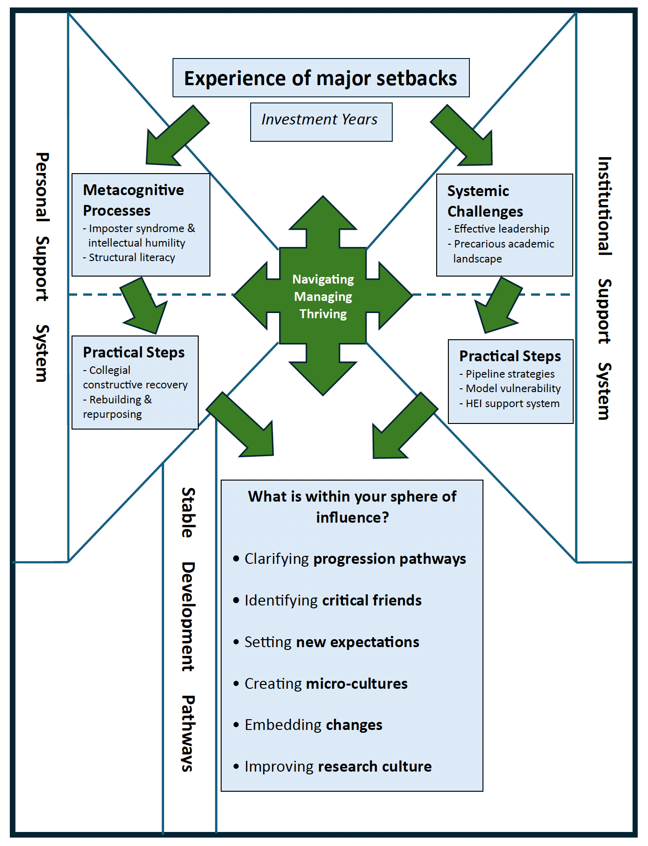
This synthesised diagram connects the dots and offers the big picture when you experience a major setback - either as an Early Career Researcher, Mid-Career Researcher or Senior Leader.
We compared and contrasted the key points highlighted by each of the researcher groups we interviewed. Notably, while there are distinct points exclusive to each group, multiple similar patterns across the three can also be observed. This exercise enabled our team to generate a holistic perspective not only of the factors leading to but also the ensuing impact and cumulative strain arising from these setbacks. Equally, our reflection has led to consideration of what we can do – individually, collectively and with support from the institution.
Confronting setbacks come in different shapes and forms (e.g. rejection following application for peer review, research grant, promotion or additional qualifications). Repeated rejections often incur deeply personal, emotionally charged reactions (i.e. bruised feelings, feelings of threat or guilt) that can easily affect any researchers’ motivation or decision to engage in a similar activity.

Slide 44
While experiencing rejection is frequently something outwith our power to prevent, our thinking and behaviour remain within our control.
In this connection, we dig deeper into two forms of support, i.e. Personal support system and Institutional support system.
Reframing perspectives on experiences of feedback as crucial ‘investment years’ towards one’s personal growth/development and/or career progression or in contributing to other colleagues’ (e.g. ECRs’) coping and thriving given academia’s challenging contexts.
To reframe one’s thinking entails focusing on what can be learned from the ‘failure in academia’ experience, enrich one’s resources, and in turn, strengthen one’s or others’ personal growth/development.

Slide 45
06 Action Planning
This synthesised diagram connects the dots and offers the big picture when you experience a major setback - either as an Early Career Researcher, Mid-Career Researcher or Senior Leader.
In the case of a major setback, consider both your personal support system and the institutional context where you work. What resources are available to you? How can you capitalise on them either to help yourself and/or help colleagues? Use our facilitators’ guide to create a development opportunity for your team, colleagues, other peers, and yourself.
Based on these reflections, what practical steps are reasonable for you to pursue?
Consider your sphere of influence in your effort to
- clarify how you want to ‘get up again’ after being ’knocked down’ by your experience?
- set your new objectives either for yourself or your colleagues
- identify your allies who can support you with your new objectives
- create a micro-culture (e.g. informal, regular meetings where ECRs can ask for support;
active listening is promoted and practised) given what is doable in your circumstances
- embed these changes from the micro-culture to create a resilient culture, in which
collegial efforts are promoted as well as celebrated

Slide 46
A simple Action Planning Template
To guide you through the toolkit
What do I want to learn about responding to failure and the role of collegial leadership?
What strengths has the toolkit helped me to identify in my approach?
What are the areas for development?
How will I achieve these?
  Support I need:
  Training I need:
  Experiences I need:
By when?
There are other reflective questions in the toolkit which can help you build your action plan.

Slide 47
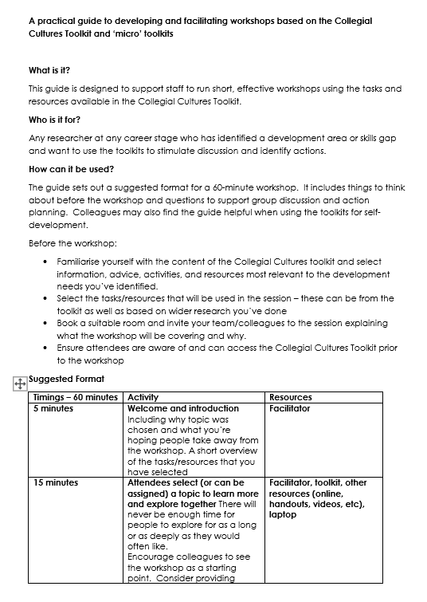
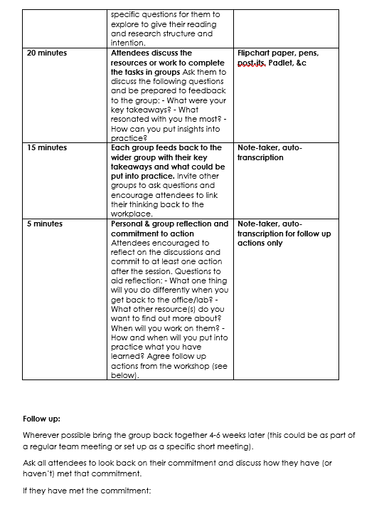
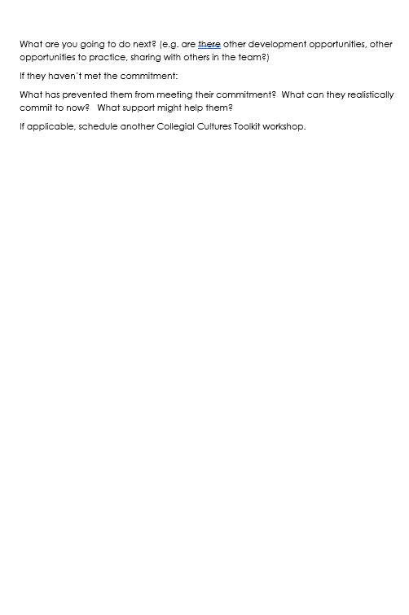

Slide 48
