Slide 1
PGDE Primary
Teaching in School 1
PGDE Primary Programme Team
October 2024

Slide 2
Overview
Learning Outcomes
Materials
People Involved
Placement Tutor role
Key points
Planning

Slide 3
Learning Outcomes
On successful completion of this course, you should be able to:
Apply knowledge and understanding of appropriate curricular content to plan purposeful learning for children
Apply knowledge, skills, and understanding of pedagogy when teaching small groups and whole classes
Engage in reflective and reflexive praxis to ensure how, why and what we teach aligns with our individual and collective professional values and action
Use a range of communication skills to professionally interact with children and sustain learning conversations
Work collaboratively under guidance in a collaborative relationship with qualified practitioners and other student teachers

Slide 4
Materials
Placement Guidelines - Updated version (2024) available from your student (or from admin edpgdep@ed.ac.uk)
Slides from this meeting (will be sent out)
Mentor’s Learn page – here – still under construction
Documents and materials available from Placement Tutors/Students

Slide 5
People Involved
School-based – Mentor Teacher (class teacher).
University-based - Placement Tutor
Course Organiser (and Programme Director) – Dr Sue Chapman (sue.chapman@ed.ac.uk)
Administrator – Rebekah Cathcart (edpgdep@ed.ac.uk)

Slide 6
Placement Tutor role
The student’s Placement Tutor will:
Make contact with the student at the end of Week 1 to check everything is ok
Set up a very short introductory digital meeting with the student and the mentor teacher during week 1 or 2 to establish lines of communication etc
Look at the student’s Teaching File several times during the placement
Visit the student during week 4 or 5 (approx.) and provide feedback
Support you and the student as necessary
They will be your first contact for anything placement-related and you/the student should get in touch with them as early as possible if there is a concern.

Slide 7
Key points
6 week placement (first week mainly observation)
Build up to full responsibility for 1 day/2 consecutive half days
In-person visit from University Placement Tutor
National Student Teacher Assessment form to be completed by Mentor Teacher (class teacher) and Placement Tutor – joint assessment
Teaching File (Onenote) – to be shared with teacher (AND Placement Tutor)

Slide 8
What do students have to do?
Teaching responsibility
4 sequences of 4 lessons - Maths, Literacy plus 2 others
This means:
4 x sequence plans
Individual lesson plans for all lessons taught
Copies of daily/weekly plans available in their files

Slide 9
Backwards Planning (Wiggins and Mctighe, 2005)
Stage 1: 1. Identify desired results.
Stage 2: Determine acceptable evidence
Stage 3: Plan learning experiences and instruction
Students will naturally gravitate to the idea of activities and resources rather than planning ‘backwards’ and different students will require support in different areas to move on their own ZPD in planning and teaching for progression and / or inclusion, so please offer the range of support and challenge you feel is needed for the individual student.

Slide 10
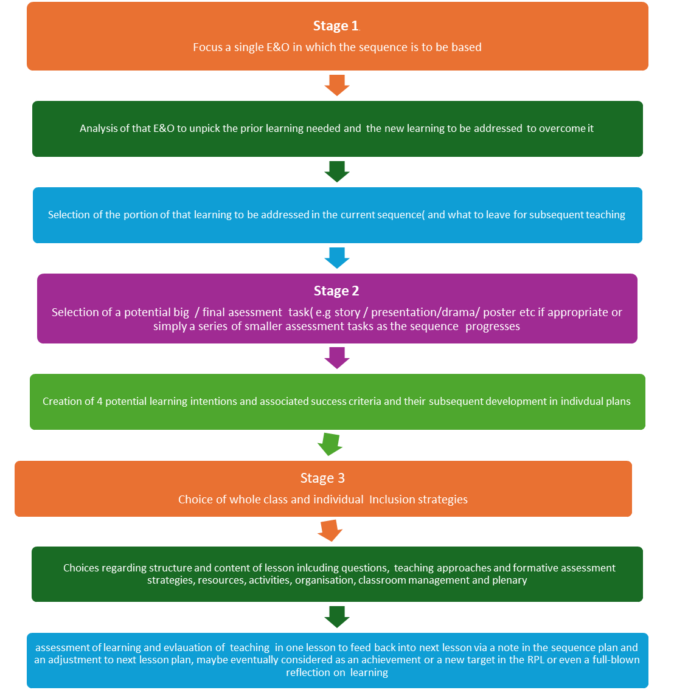

Slide 11
Documents
Assessment form – held by tutor on OneDrive and link sent to you. Working document – we don’t assess at the point of the tutor visit.
Teaching File
Lesson Plans and Sequence plans (with Assessment of Learning and Evaluation of Teaching completed)
Record of Professional Learning – weekly target setting document
Weekly reflection (linked to reading)
Weekly written feedback from Mentor Teacher

Slide 12
Notes on Assessment
Language – students are ‘on the trajectory to pass’ or a cause for concern has been noted because they are not.
If you have a concern about a student’s progress, please discus with the Placement Tutor – we have a cause for concern form/Action plan to be completed and recorded.
Progress Check – very short document to be completed at the end of Week 3 by both Mentor Teacher and Placement Tutor.

Slide 13
Questions?
One for you – what else would be helpful here to support YOU as you support our students?

